Slide 1
Sentiment Analysis of Tweets
Text Information Systems
Fall 2022 Final Project Presentation
Yadav, Hitesh (hitesh2@illinois.edu)
Srinivasan, Gopikrishnan (gs25@illinois.edu)
Bhaskar, Shubhendu (sb59@illinois.edu)
Goel, Chandan (chandan3@illinois.edu)
Singh,Sanjeev (sksingh6@illinois.edu)
Notes:
Hello everyone,
Greetings of the Day
My name is Chandan. Today I along with my team mates are going to walk you through the final project presentation for class CS410, Text Information Systems. For our final project, have chosen the Sentiment Analysis of Tweets.

Slide 2
Agenda
Overview
Data
Model Comparison and Evaluation
High Level Architecture
High Level Code Walkthrough
How to run the application?
Demo
Notes:
In this presentation, we are going to cover the following.
We will start by giving our audience an overview of the application including the motivation of choosing the topic
We will them discuss the dataset used this application.
Followed by a high-level overview of different models that we used and how they compare against each other.
We will them walk you though the high-level architecture of the application along with an overview of the code used to perform sentiment analysis.
At the end, we will provide the audience with steps on how to run the application along with the demo.

Slide 3
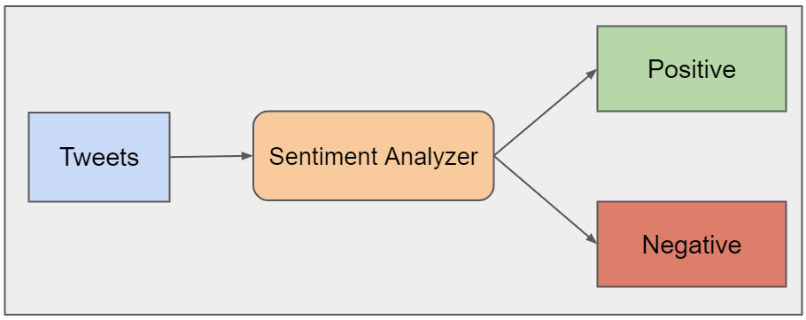
Overview
What is Sentiment Analysis?
Sentiment Analysis of Tweets
Motivation

Slide 4
Data
Kaggle is used as the dataset for building the model
Only columns chosen are “target” and “text”; the other columns like user, ids, date etc. are irrelevant in sentiment prediction therefore, these columns in the datasets are ignored.
Replaced the target code of “positive” tweets from “4” to “1“. Negative tweets are still represented by 0.

Slide 5
Model Comparison
To compare different models based on their performance, ROC curves for 5 different models were generated. Based on the ROC plots shown below, it was confirmed that for Twitter Sentiment Analysis, Logistic Regression model is the best suited model as compared to the other models.
Following were the models chosen for comparison:
Gaussian Naïve Bayes
Logistic Regression
Decision Tree Classifier
Random Forest Classifier
K-Neighbors Classifier

Slide 6
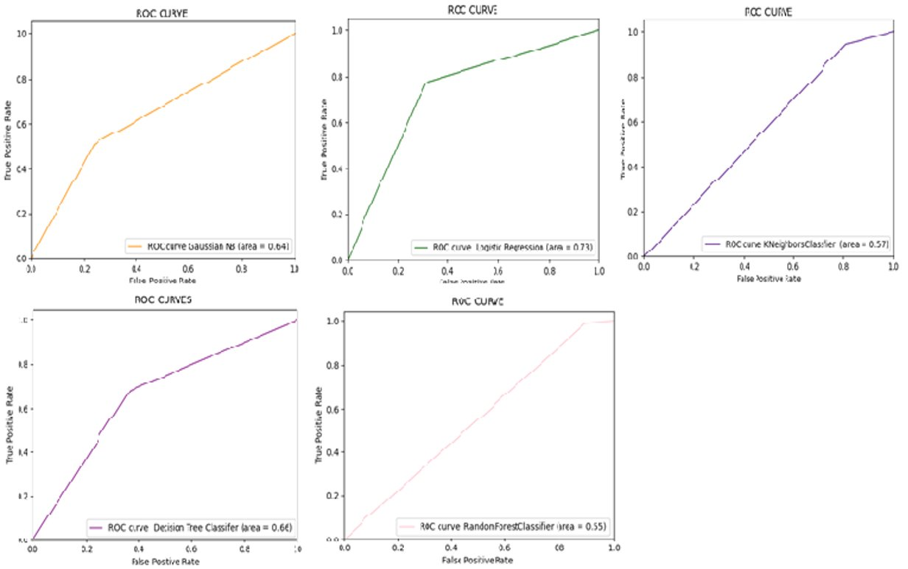
Model Comparison(Continued..)

Slide 7
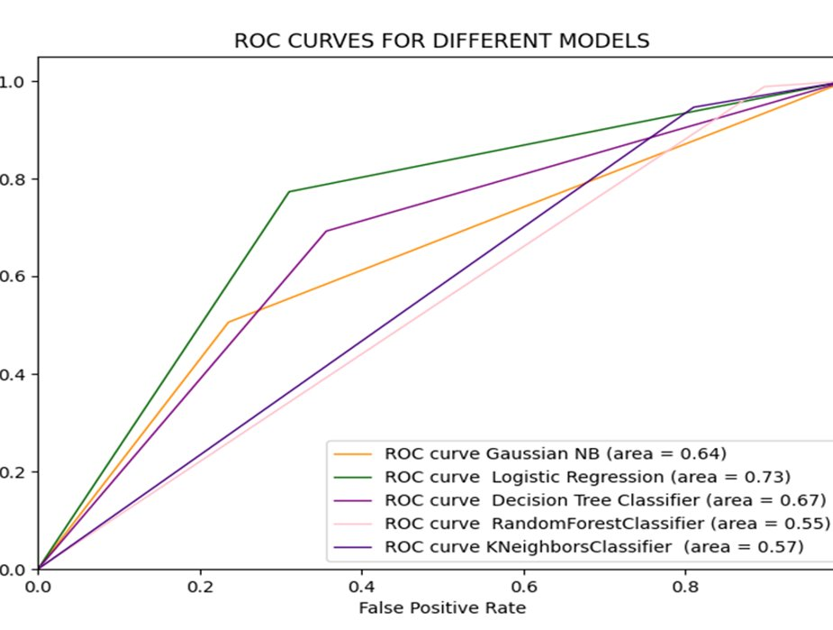
Model Comparison Conclusion
The order of ROC AUC Score for the models: Logistic Regression (0.73) > Decision Tree Classifier (0.67) > Gaussian NB (0.64) > K-Neighbors Classifier (0.57) > Random Forest Classifier (0.55)
Logistic Regression model performed best with 73% chance . Therefore, Logistic Regression model is used for generating our sentiment analysis

Slide 8
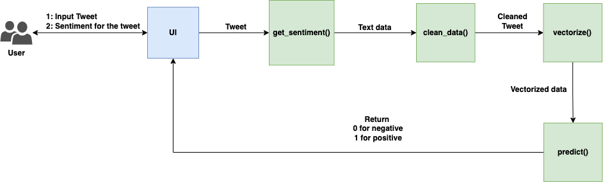
High Level Architecture

Slide 9
How to run the application?
Download the code from the GitHub link.
Run Backend Server
Install the required dependencies using pip install -r requirements.txt
Go to the directory backend cd backend
Run the NLTK modules file: python nltk_modules.py
Run the server using python server.py
Run Frontend Server
Go to the directory frontend cd frontend
Install the dependencies: npm install
Run the app: npm start
Open a browser and go to URL: http://localhost:3000

Slide 10
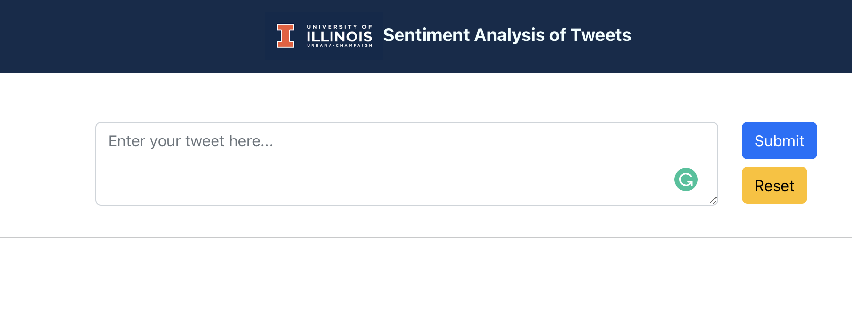
How to run the application?
The user is required to enter the tweet in the provided text box. Click the “Submit” button to analyze the tweet and produce the corresponding analysis output. ​

Slide 11


Demo https://mediaspace.illinois.edu/media/t/1_ulbtkacf

